Slide 1


Circle 2.0 From the Circle of young Intrapreneurs
BUSINESS (RE)DEFINED

Slide 2
intrapreneurship Value Prop
Growth
“Virgin could never have grown into the group of more than 200 companies it is now, were it not for a steady stream of intrapreneurs who looked for and developed opportunities, often leading efforts that went against the grain.” Richard Branson
Talent Management
Each leaver in the UK costs companies up to £30,000 and the UK economy as a whole £4.1billion (The Telegraph 2014)
US organisations lose $450 billion a year in lost productivity (Simon Sinek, 2017)
“(Social) Intrapreneurship is THE new model for talent retention and development (COYI, 2018)
Leadership Development
The most effective leaders in an organisation demonstrate an 'entrepreneurial mindset' (Altringer, 2013 yet “70 percent of entrepreneurs say they left previous corporate roles because they felt stifled” (Presidio Graduate School)
Innovation
An institutional approach to intrapreneurship, whereby innovation is central to the operations of the company, can both drive growth in new markets and defend strong positions against incumbents (Forbes, 2016)
Culture
Intrapreneurs can transform an organization more quickly and effectively than others because they are self‐motivated freethinkers, masters at navigating around bureaucratic and political inertia” (HBR, 2013)
* Prevent Company Failure*
Nokia had the idea for the smart phone, Kodak the digital camera…but they had no programme to source and deliver these ideas effectively. In short they had no intrapreneurship programme and they failed as a result.
AND – “Debranding” innovation programmes is proven to increase innovation (Dann, 2015) therefore using Circle 2.0, as an external party, will create the most effective innovation programmes!
*Please ask us for our detailed report on the business case for intrapreneurship or find it at intrapreneur.com

Slide 3
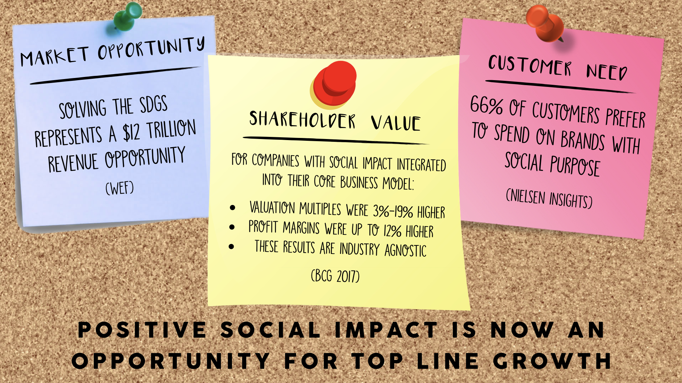
Social Impact Value Prop

Slide 4
“HOW DO WE COMBINE THE BENEFITS OF INTRAPRENEURSHIP AND SOCIAL IMPACT???”

Slide 5
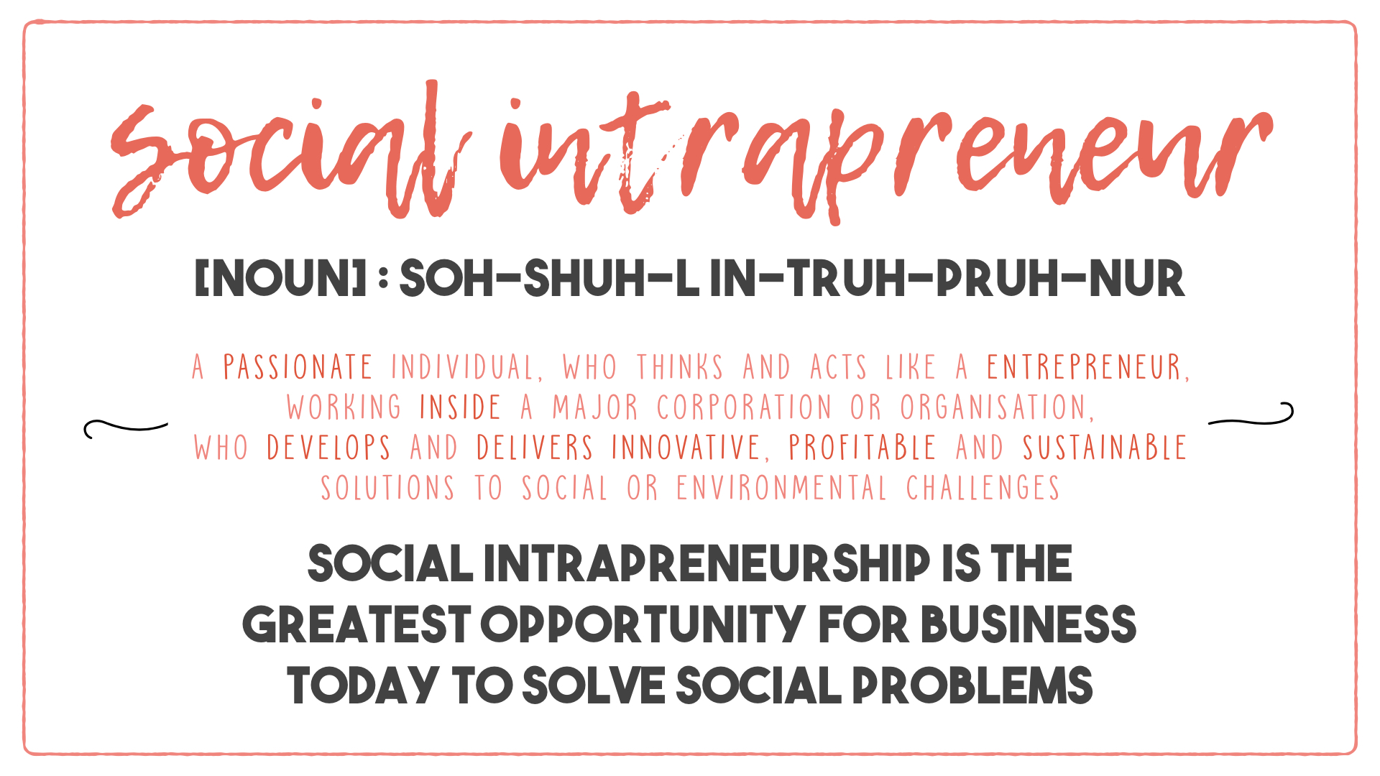

Slide 6





Intrapreneurship maturity model
Maturity Programme | 1. Beginner Interest and excitement but no structured intrapreneurship programme | 2. Novice Early stage programme which can source ideas and give a degree of ideation support | 3. Rising Star Programme in place which sources, ideates and funds ideas but delivery is rare or lengthy | 4. Superman #winning
Intrapreneurship | Circle deliverables Full Package – delivery of E2E Intrapreneurship programme with all supporting structures Time taken to delivery of projects: ∞ | Circle deliverables Time taken to delivery of projects: >2 years | Circle deliverables Using our unique delivery expertise to add a delivery ‘module’ to the existing programme Time taken to delivery of projects: 18 months to 2 years | Circle deliverables Time taken to delivery of projects: <12 months
Social Intrapreneurship | Circle deliverables Time taken to deliver: ∞ | Circle deliverables Time taken to delivery of projects: >4 years | Circle deliverables Time taken to delivery of projects: 2 to 4 years | Circle deliverables Time taken to delivery of projects: 12 to 18 months

Slide 7
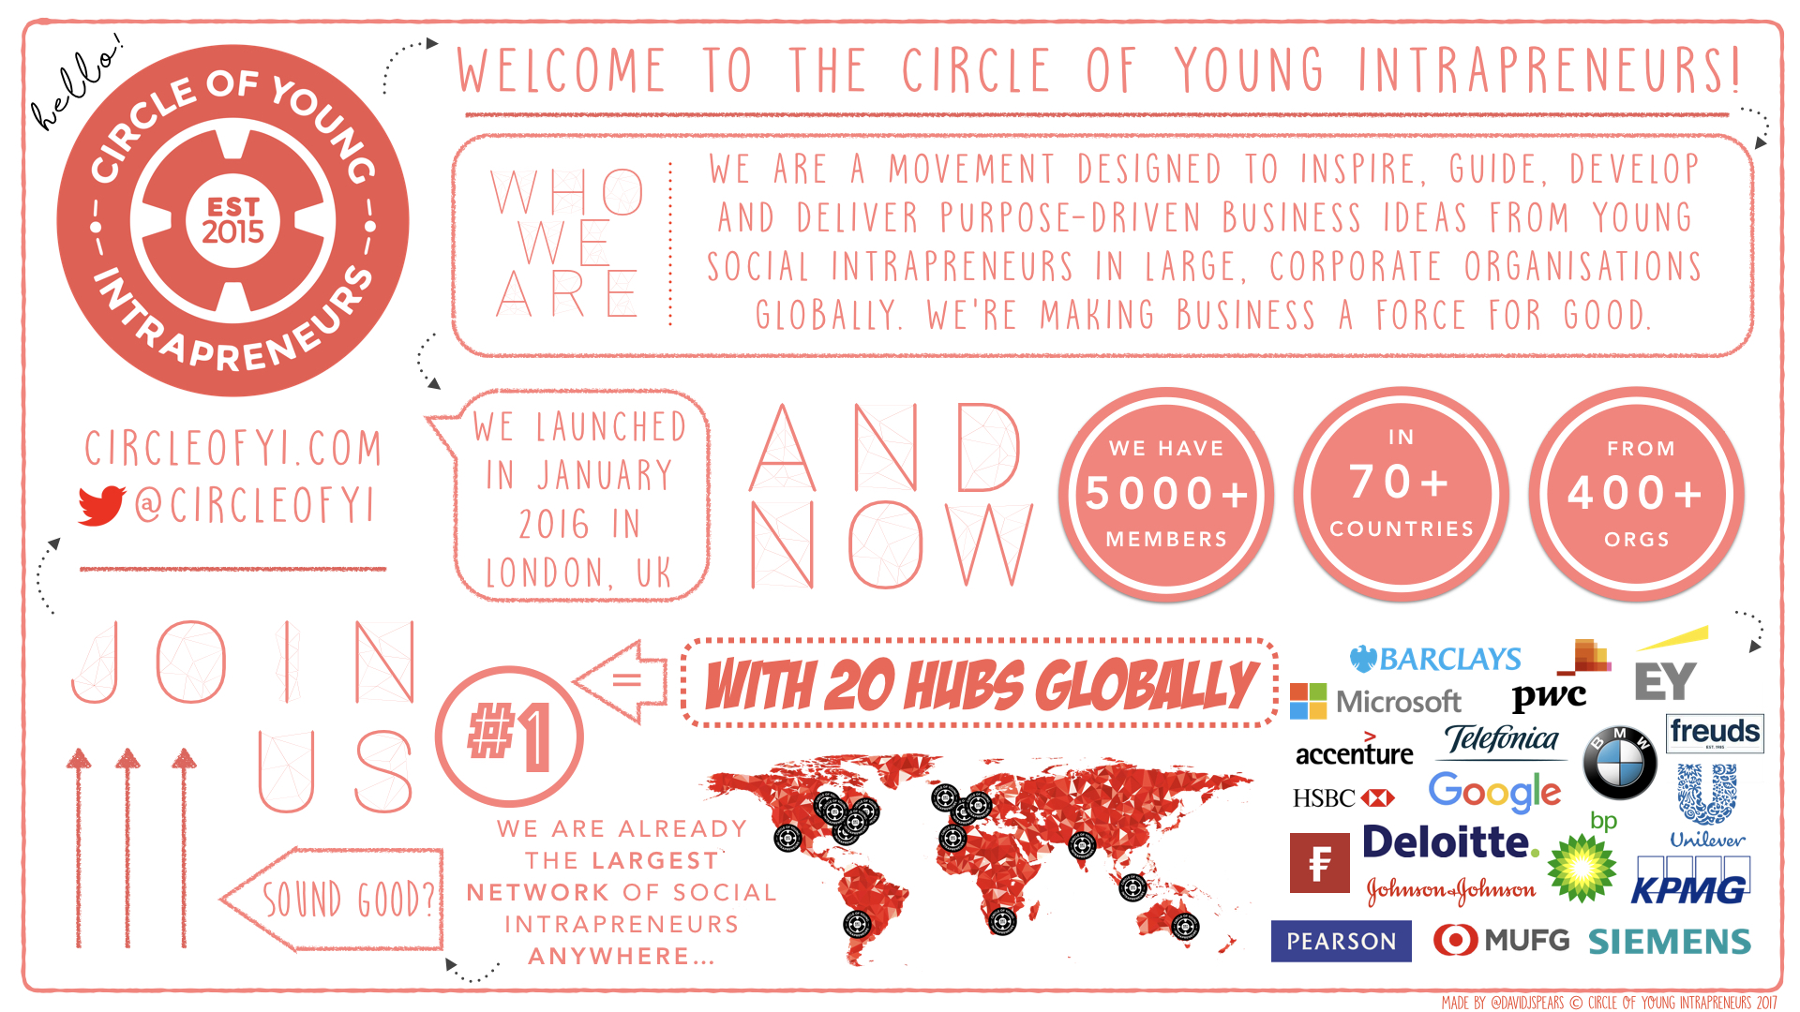

Slide 8

...Crowd Sourcing Intrapreneurship Best Practice From…

Slide 9





our 5C Project Lifecycle
Convert
Create
Construct
Commit
Control
Time, Energy & Resources
"designed by Flaticon

Slide 10
5c Project lifecycle explained
Convert
Create
Construct
Commit
Control
∞
1 month
1 month
6 – 12 months
∞
Understand the principles of intrapreneurship and identify a project idea
Confirm the problem being solved, test the need with your customers, and create a high level solution
Further develop the idea, build a business case and a pitch deck to pitch for funding
Deliver the MVP, launch a pilot and refine the product based on feedback
Complete the pilot phase, scale the product and create a pool of Intrapreneurs for future programmes!
Launch session
Intrapreneurship training
Leverage our Research Arm’s thought leadership
Run ideation kick off sessions
Delivery Training using our how to deliver purpose driven projects methodology
Build support structures for delivery
Pitch deck template
Pitch coaching
Identify Circle member skills suitable for project collaboration
Provide strategic support and mentoring for projects
Our how to deliver purpose-driven projects methodology
Access to expert Intrapreneurs
Identify project hotspots and accelerate support where needed
Refine delivery methodology
Embed and improve the programme to foster a culture of intrapreneurship
Support
From
Circle
HQ

Slide 11
SUMMARY OF Activities
This project will produce these Deliverables:
∙ NOUN – A fully functioning intrapreneurship programme which finds, funds, develops and delivers purpose driven projects across the professional services team which have both social and business benefit
∙ NOUN – Completed training programmes, tailored to grades/roles, to support the embedding of the social intrapreneurship programme and ongoing iterative cultural improvement
∙ NOUN - Intrapreneurship programme fully integrated into talent and leadership management processes driving employee engagement and staff retention
These Deliverables will be achieved by undertaking the following tasks:
∙ VERB – Scoping out the business; its key strategic aims, structures, capabilities and purpose (or desired purpose) and using this to judge degree of intrapreneurship maturity
∙ VERB - Developing a bespoke intrapreneurship programme which creates projects aligned to the objectives of the business
∙ VERB - Integrating the intrapreneurship programme with the talent management and leadership development strategies to ensure it delivers against the business’; people plan
∙ VERB - Training senior management to create supporters for the programme and the intrapreneurs themselves
∙ VERB - Inspiring more junior staff to get involved and become intrapreneurs
∙ VERB - Defining a clear communications strategy to support the intrapreneurship programme at all life stages
∙ VERB - Establishing an intrapreneurship programme which can be expanded and improved cycle by cycle
The project will be successful if:
∙ SUCCESS CRITERIA #1 - The intrapreneurship programme creates viable projects for the business with clear business benefits
∙ SUCCESS CRITERIA #2 - Employee engagement and staff retention metrics improve according to pre agreed parameters
∙ SUCCESS CRITERIA #3 - The intrapreneurship programme successfully embeds the wider cultural transformation programme
Leading too….

Slide 12
…Perpetual, proactive, persistent and positive cultural transformation

